Slide 1
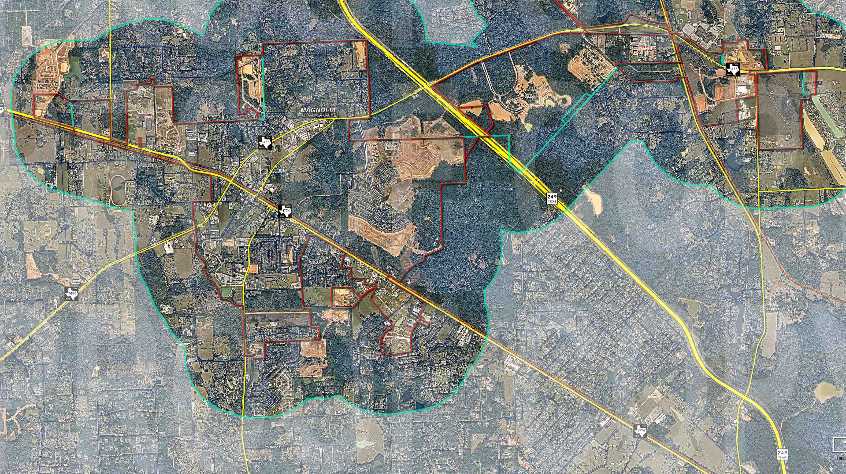
Magnolia, Tx FM 149 Summary

Slide 2
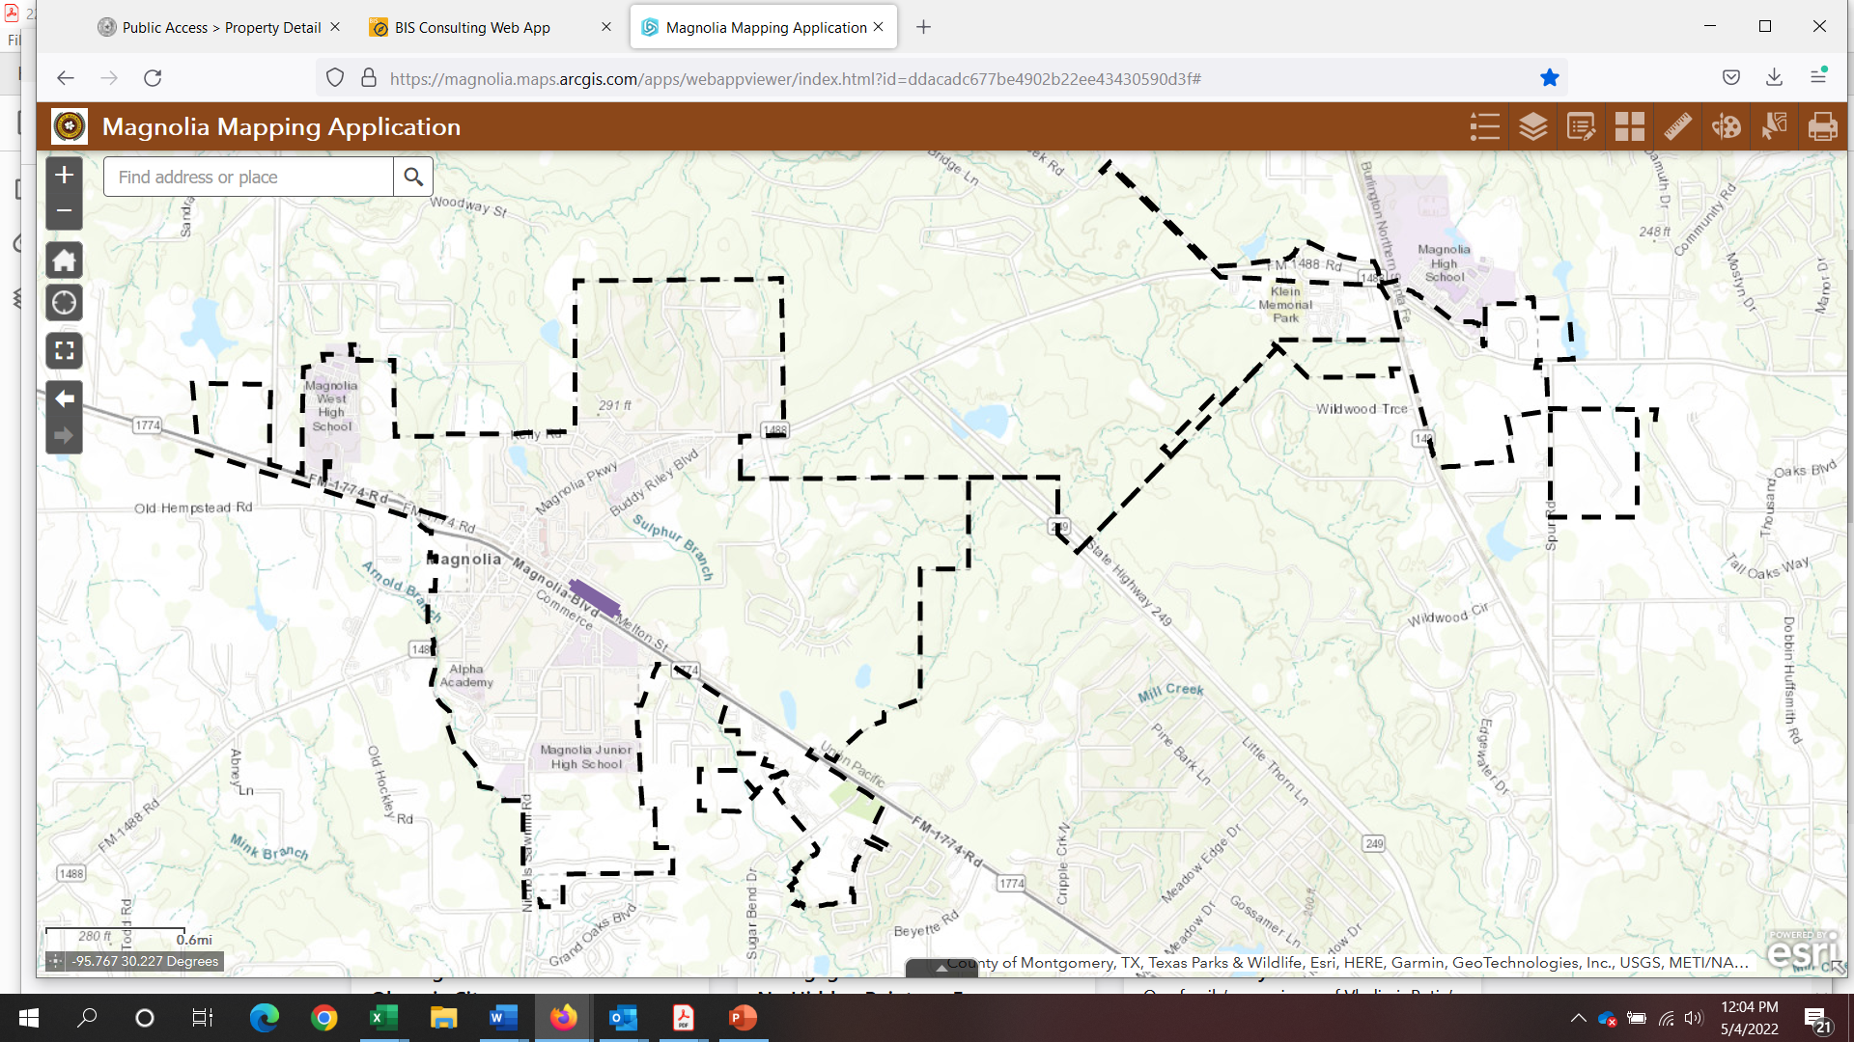
FM 149 AREA MAP

Slide 3
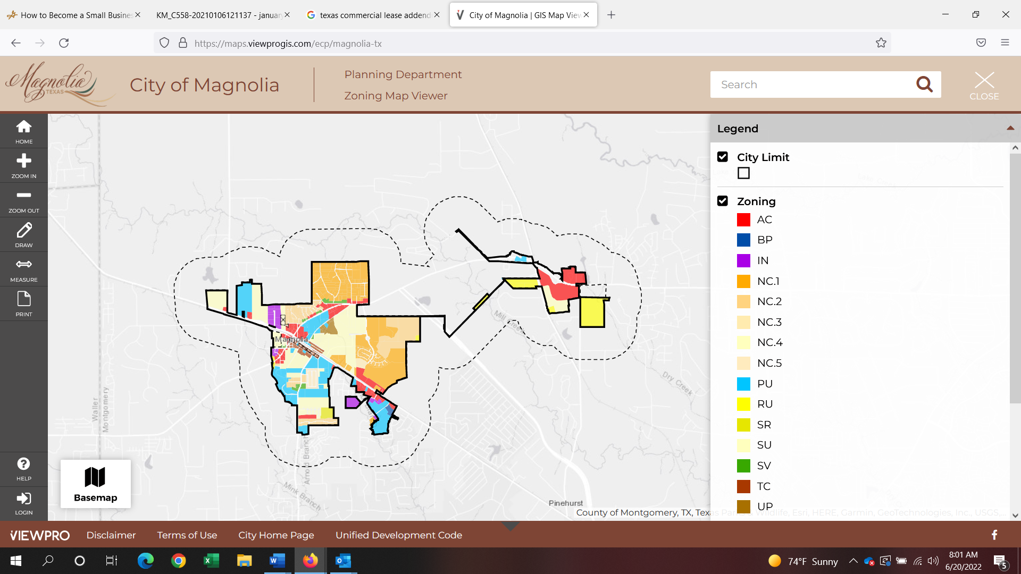
Land Use Map
Available at https://maps.viewprogis.com/ecp/magnolia-tx

Slide 4
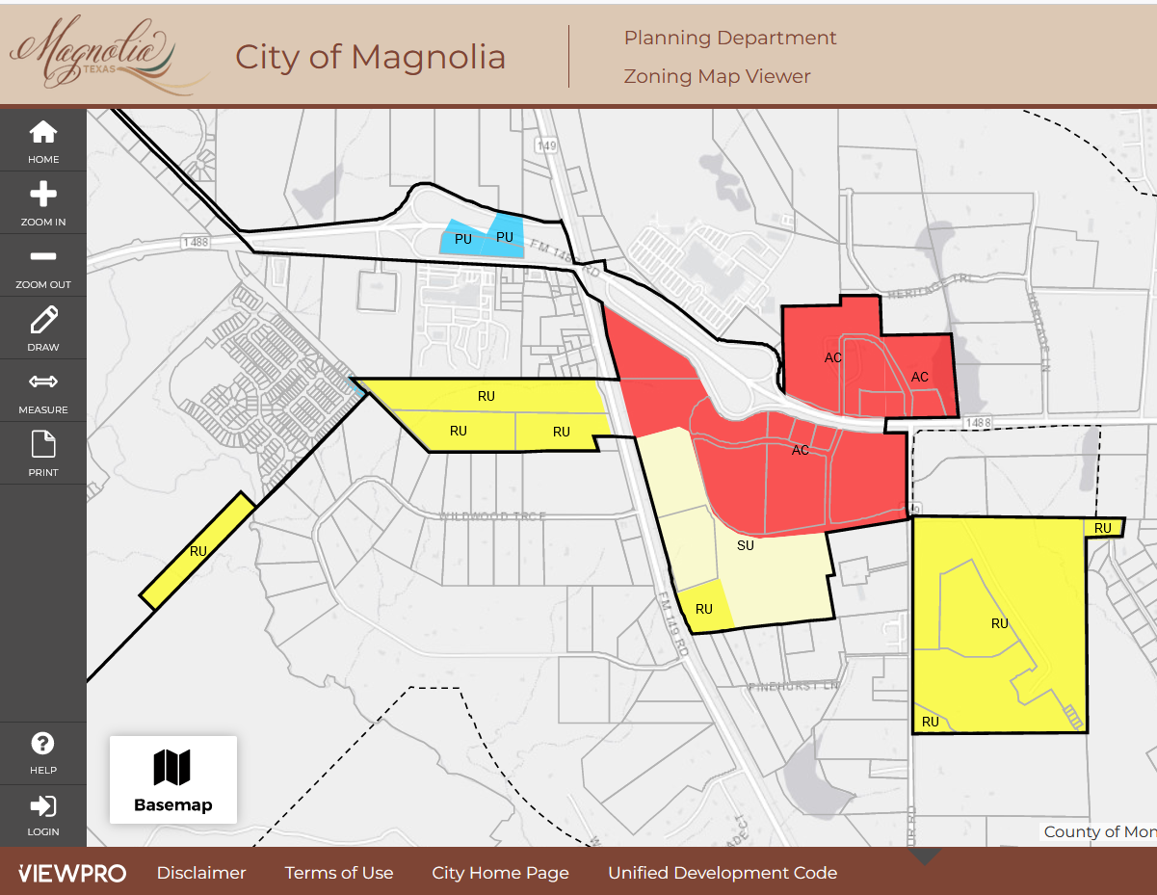
ZONING Current Zoning: RU Non-Residential Zoning Districts Available: Suburban Village (SV); Auto-Urban Commercial (AC); Town Center (TC); Unity Plaza (UP); Business Park (BP); Industrial (IN) Magnolia, Tx Unified Development Code, Ch. 2- Article 2. http://online.encodeplus.com/regs/magnolia-tx/index.aspx

Slide 5
UTILITIES MAP: Green Line: Gravity Sewer Line Blue Line: Water Blue Dots: Valves Dotted black: City limits

